Slide 1

JOB SEARCH PLATFORM
Team 1
Muni Sai Kalyan Teja Dudi - 1002104402
Richithareddy Gorlagunta - 1002126204

Slide 2
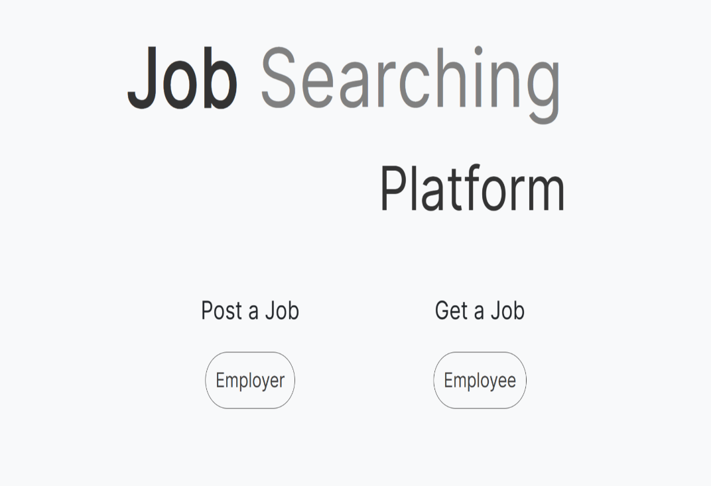
Introduction
The "Job Search Platform" project is an ambitious endeavor aimed at creating a comprehensive and transformative solution for job seekers, employers, and recruiters in the contemporary job market. This platform will serve as a bridge connecting job seekers to their dream careers and employers to the ideal candidates they seek.

Slide 3
Planning
We have adopted an iterative and user-centric approach. We will combine elements of Waterfall SDLC Design methodologies to ensure that the end product meets user needs and is adaptable to changing requirements.
user-centric approach(User Research, Prototyping, Usability Testing, Accessability, Responsive Design)
Roles
Muni Sai Kalyan Teja Dudi | Richithareddy Goralagunta
Gathering Requirements Backend Development(Authentication, Functionality) Database setup to server Testing Documentation | Developing Project Scope & Plan Frontend Development(Home page, listing page, Employee and Employer pages) UI Design Database Connectivity Documentation

Slide 4
Work Breakdown Structure(WBS)
A Work Breakdown Structure (WBS) is a hierarchical decomposition of the project into smaller, manageable work packages. Here's a simplified WBS for the Job Search Platform project:
1. Project Initiation
1.1. Project Proposal
1.2. Feasibility Study
1.3. Cost and Time Estimation
2. Design and Development
2.1. Landing Page Development
2.2. Registration and Login Pages
2.3. Employer Dashboard
2.3.1. Job Listing Creation
2.3.2. Job Listing Editing
2.3.3. Job Listing Deletion
2.4. Employee Dashboard
2.4.1. Job Search Functionality
2.5. User Profile Pages (Future Phase)
2.6. Notifications System (Future Phase)
3. Testing and Quality Assurance
3.1. Unit Testing
3.2. User Acceptance Testing
3.3. Bug Fixing and Issue Resolution
4. Deployment
4.1. Prepare for Production Deployment
4.2. Choose Hosting Platform
4.3. Deploy Web Application
5. Documentation and User Guides
5.1. Create User Documentation
5.2. Develop User Guides

Slide 5
Gantt Chart
Burndown Chart

Slide 6
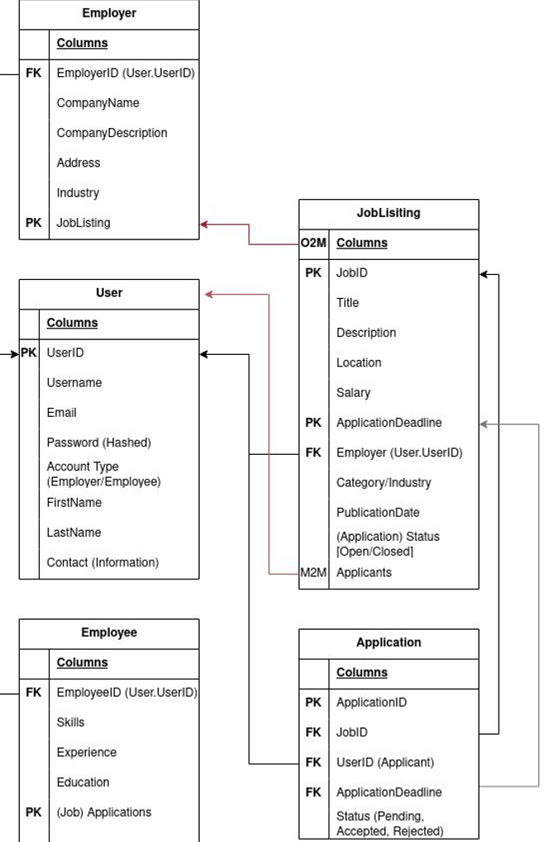
Design
ER Diagram
Modules:
We have designed two modules they are:
Employer
Employee
1. Employer
Register and Login.
Add a job with complete information.
2. Employee
Register and Login.
Search for Job and apply.

Slide 7
Implementation
In the implementation phase of the Job Search Platform project, we will leverage a variety of tools, frameworks, libraries, and technologies to build a robust and efficient web application. Here are some of the key components we plan to use:
Frontend: HTML, CSS(Bootstrap), JavaScript
Flask, Flask Security, VS coding,
Backend: Python
Database: FaunaDB
These tools, frameworks, and libraries have been carefully selected to support efficient development, enhance collaboration, ensure quality, and deliver a scalable and user-friendly Job Search Platform web application. The choice of specific tools may be subject to project requirements and constraints.

Slide 8
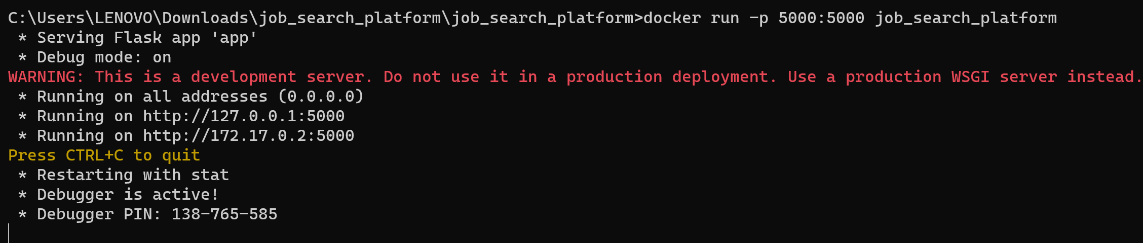
Testing
Unit Testing: PyTest, a testing framework for Python, will be used for unit testing to ensure the correctness of our code.

Slide 9
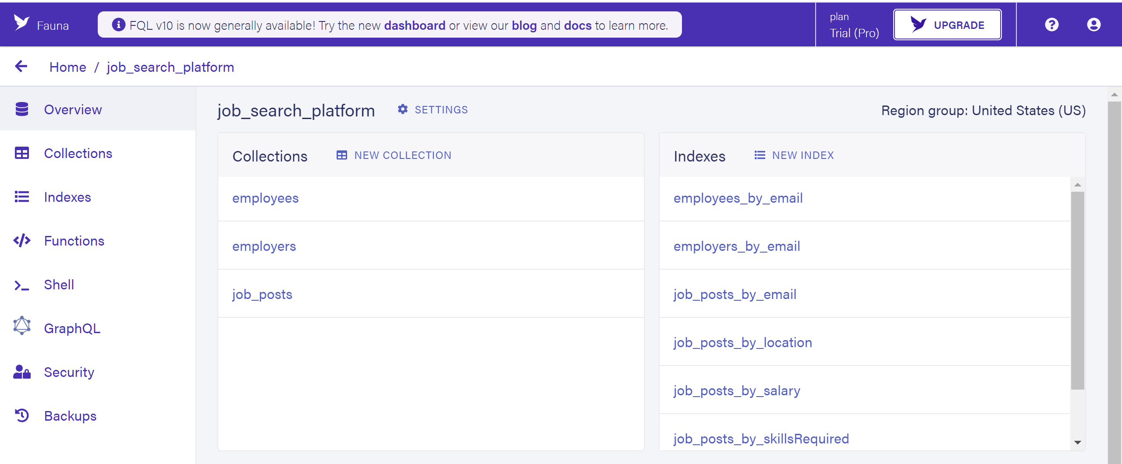
Integration Testing: Testing the interaction between the frontend and backend, as well as external services like FaunaDB.

Slide 10
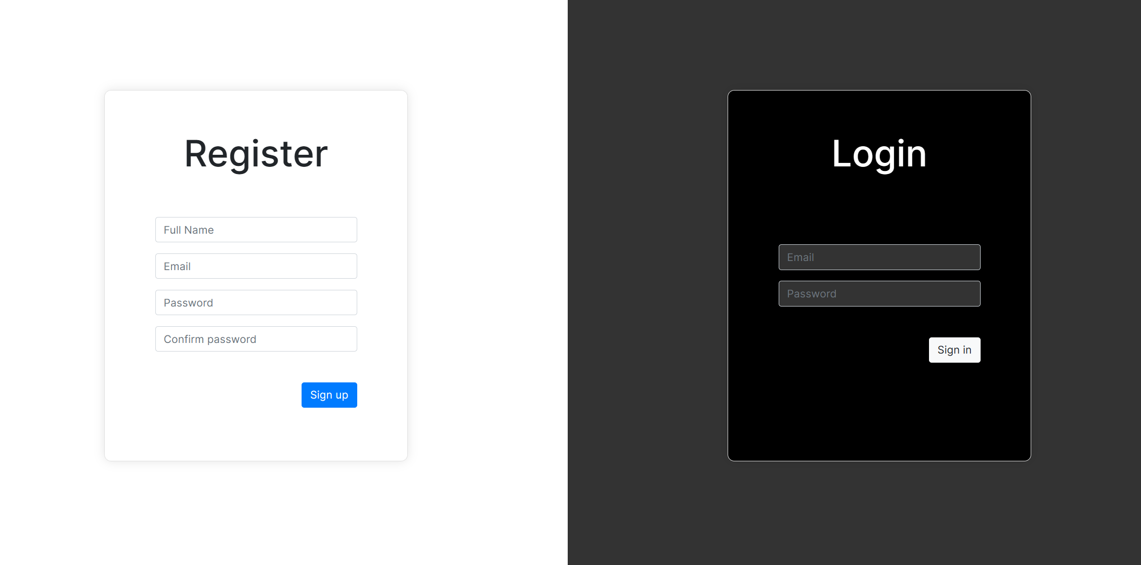
User Acceptance Testing: It will be employed for automated UI testing to verify the functionality and user experience of the web application.

Slide 11
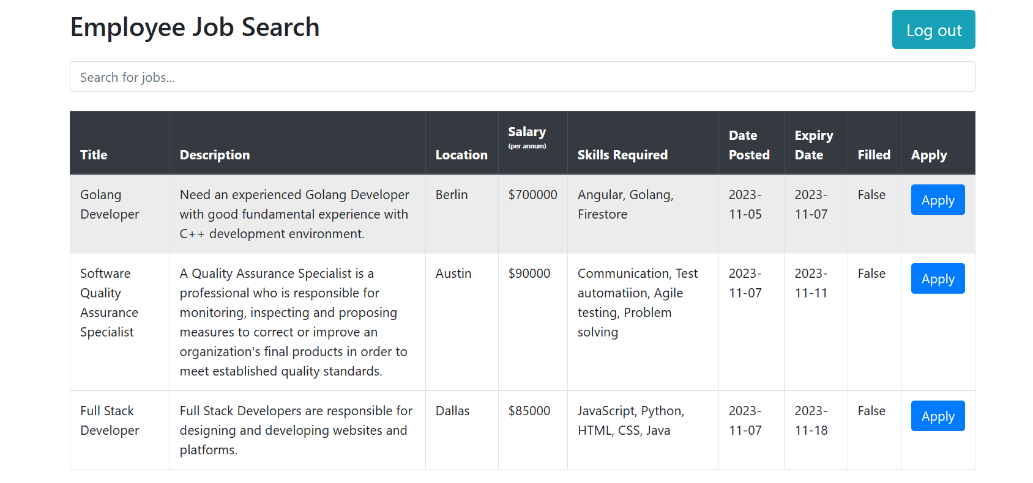
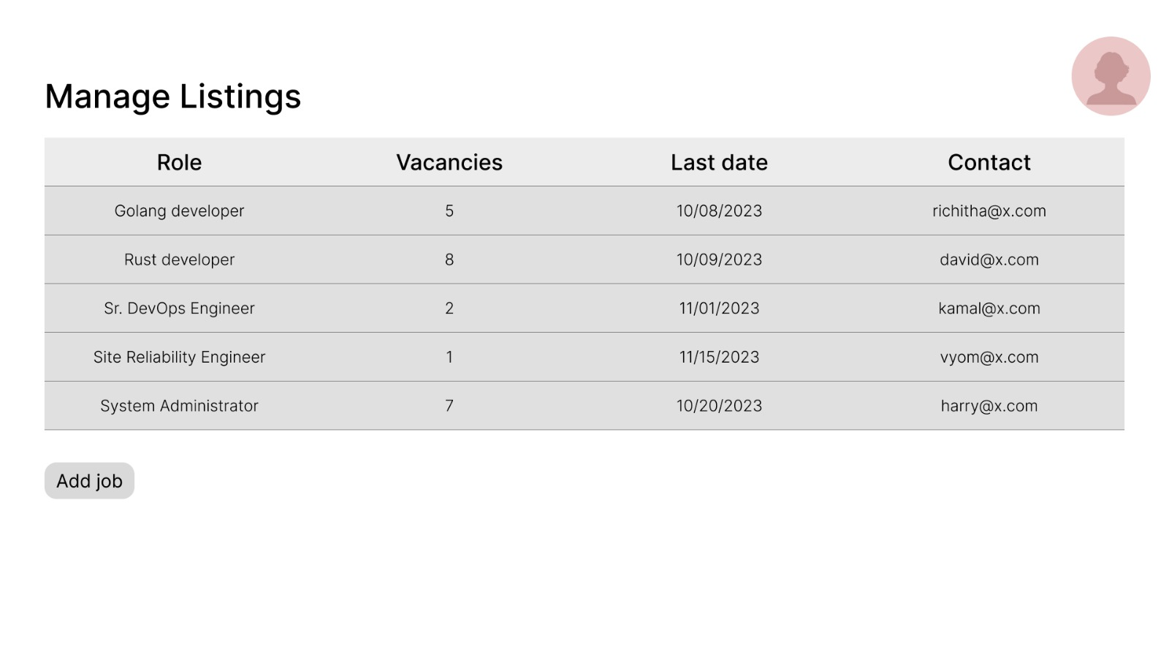

Slide 12
Conclusion & Future Work
This Platform provides first come first serve basis in applying for the job for the employees. There will be direct contact with the employer through mails when applying to the job.
This platform have the potential to shape the future of software engineering careers, making the hiring process more efficient, transparent, and empowering for both job seekers and employers alike. In future it can also be developed in Android Application to make things ease.

Slide 13


Slide 14
THANK YOU

